Slide 1

Internals of Google BigQuery and Best Practices

Slide 2
This talk
What is BigQuery?
BigQuery Architecture
Dremel Architecture
Columnar Storage
Capacitors
Tree Architecture Query Execution
Best Practices

Slide 3
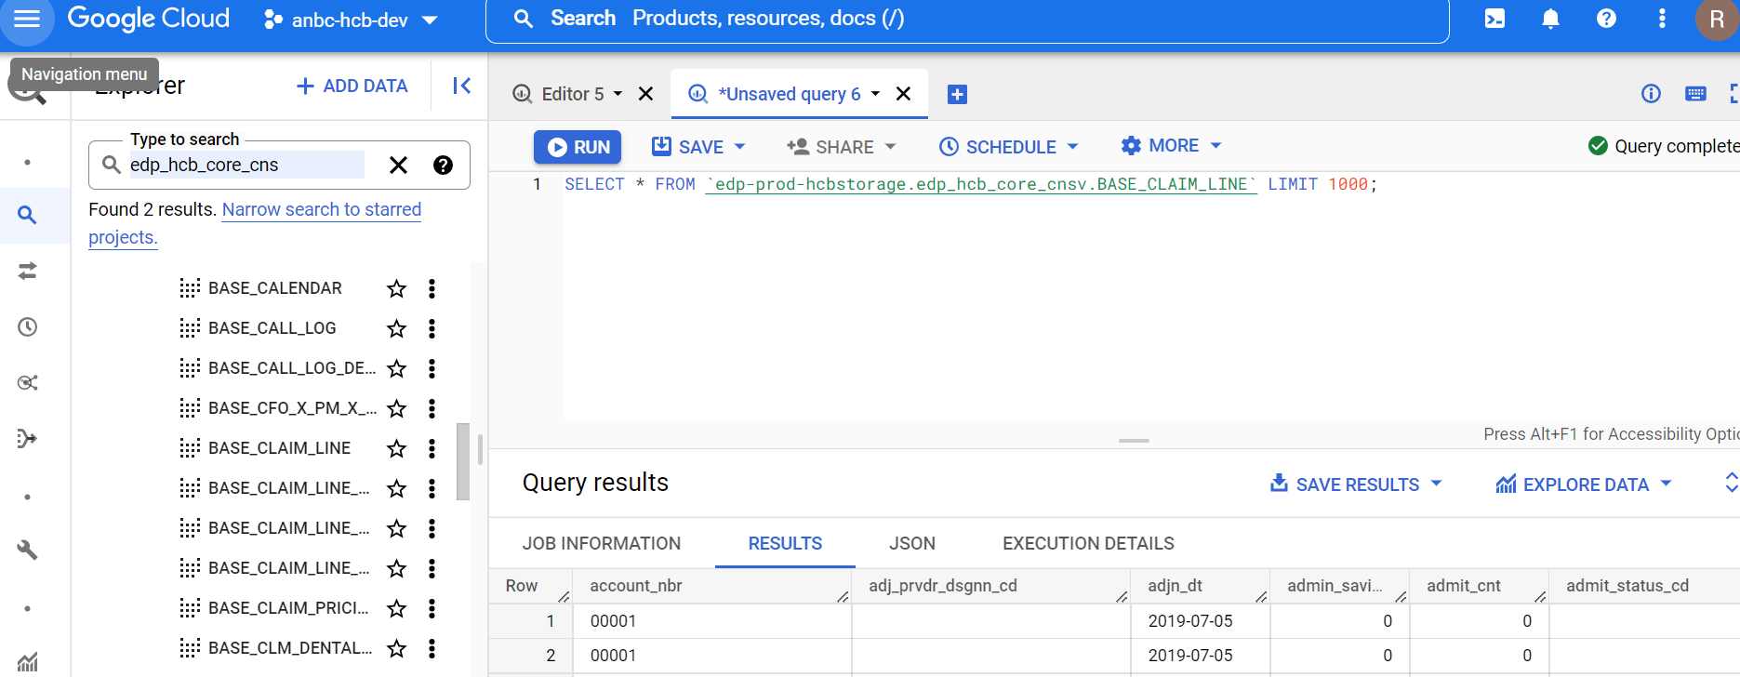
What is Big Query?
Google Big Query is a Cloud Datawarehouse run by Google. It is fully managed and cloud-based interactive query service for massive datasets.
It is externalization of Dremel , Google core technology.
Big Query service is available via:
- Web UI
- Console
- API(client libraries)
- external tools
- OBDC connectors

Slide 4
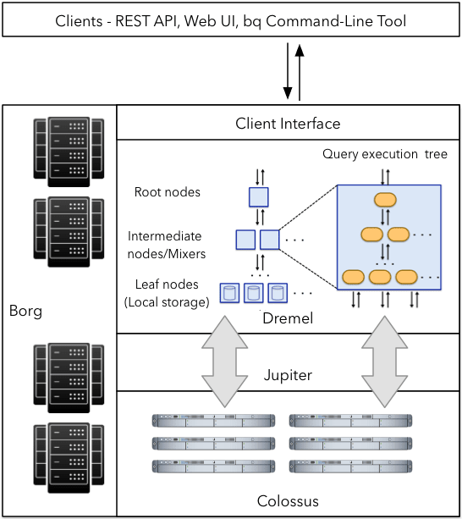
What is the Google BigQuery Architecture?
Dremel : Dremel is a scalable, interactive ad hoc query system for analysis of read-only nested data. By combining multilevel execution trees and columnar data layout, it is capable of running aggregation queries over trillion-row tables in seconds
Colossus: is cluster-level file system, successor to the Google File System (GFS). Leveraging techniques such as Reed Solomon codes to ensure that data is never lost.
Jupiter: The internal data center network that allows Big Query to separate storage and compute.
Borg: a scalable job scheduler that launches everything from compute to storage services. It was and continues to be a big influence on the design and development of Kubernetes.

Slide 5
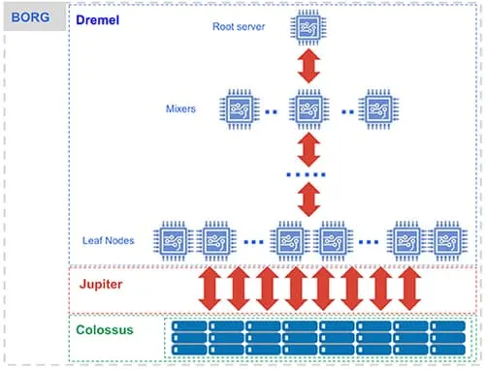
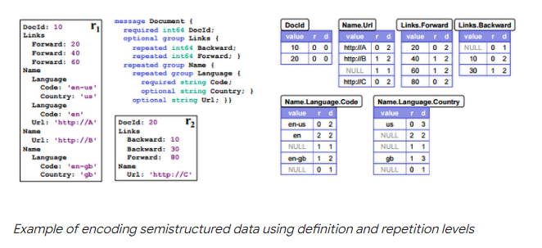
Dremel Architecture
Data Model/Storage:
- Columnar Storage
- Nested/Repeated Fields
No index
-Query Execution:
Tree Architecture
Using ten of thousands of Machines over fast google network(+1 Petabits/s)

Slide 6
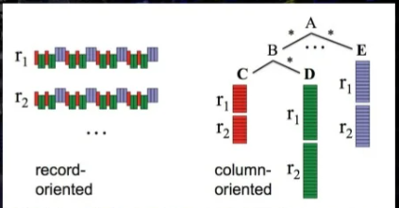
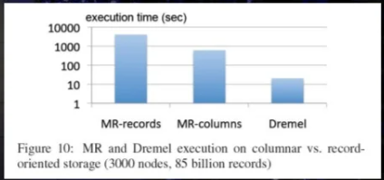
Columnar Storage
Traffic Minimization:
Only read selected Columns
Higher Compression Ration
Similar Values in same columns
From 1:3 to 1:10

Slide 7
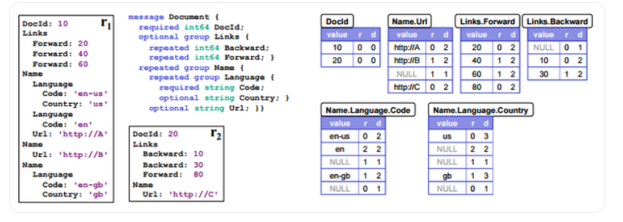
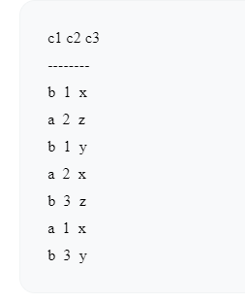
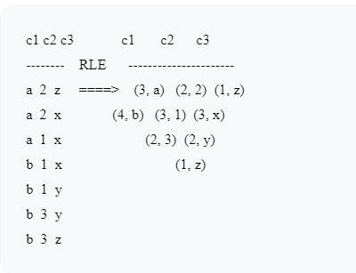
Capacitor : Storage Format in BigQuery
Internally, BigQuery store data in proprietary columnar format called Capacitor.
Capacitor builds an approximation model. that takes in relevant factors like the type of data (and usage of the data in order to reshuffle rows and encode columns.
Capacitor and BigQuery collect various statistics about the data — these statistics are persisted and later are used during query execution.
RLE would be 1 and 21 runs.
Take great advantage of RLE, and will end up with a total of 9 runs

Slide 8
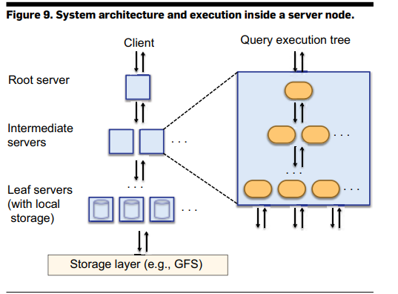
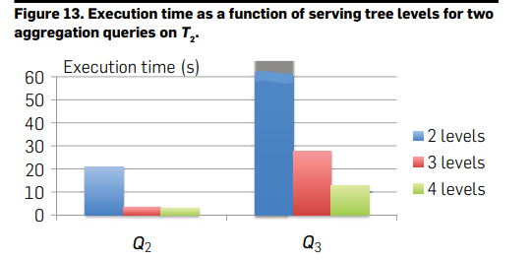
Query Execution : Tree Architecture
Root Server
Receive Query + reads table metadata
Rewrites the query(s)
Send queries to the next level
Return final query result
Intermediate servers:
(similar steps)
Parallel partial aggregation
Leaf Server
Actually, Scan parts of the table.
Send data to intermediate servers

Slide 9
Best Practices

Slide 10
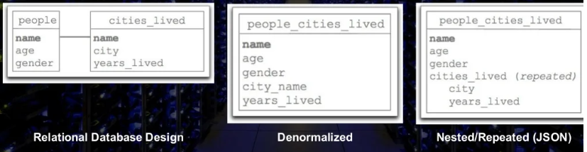
Denormalize / Pre-Join Where Possible
Best Performance
Only pay for Columns you need
Nested / repeated filed

Slide 11
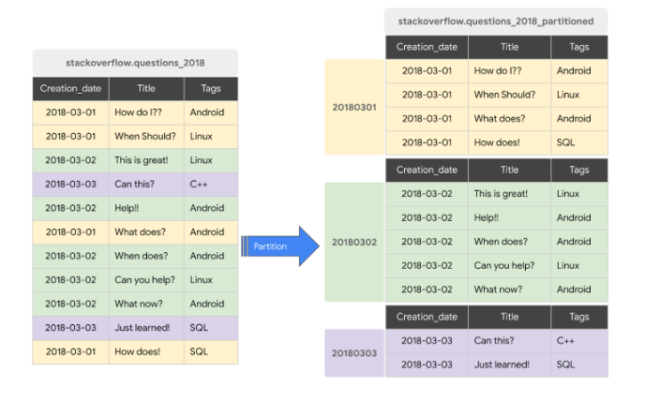
Partitioning
. A partitioned table is a special table that is divided into segments, called partition.
BigQuery leverages partitioning to minimize the amount of data that workers read from disk.
BigQuery supports the following ways to create partitioned tables:
- Ingestion Time Partitioned tables
- Time –Unit Column Partition
- Integer range partition.

Slide 12
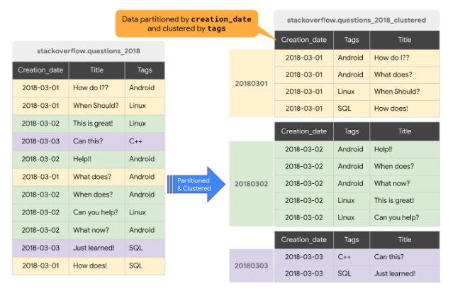
Clustering
When table is clustered, the data is automatically sorted based on the contents of one or more columns (up to 4, that you specify).
Usually high cardinality and non-temporal columns are preferred for clustering, as opposed to partitioning which is better for fields with lower cardinality.
Clustering can improve the performance of certain types of queries such as queries that use filter clauses and queries that aggregate data
The main cost of clustering is longer load times, but sometime worth it.

Slide 13
Optimize for Query vs. Storage Costs
Common Queries ?
Materialized Views
With Pre-aggregated data: faster + cheaper queries
Store data in multiple table
- table for daily data
- table for weekly data
- table for monthly data

Slide 14

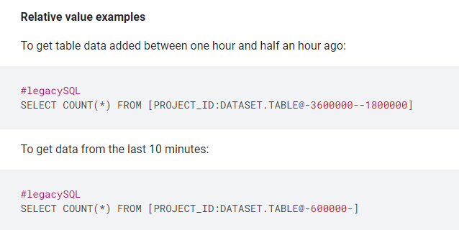
Table Decorators
Only way to avoid full table scans.
Perform a more cost-effective query of a subset of your data.
Table decorator support relative and absolute <time> value.
Time Decorators
Range Decorator
Undelete table

Slide 15
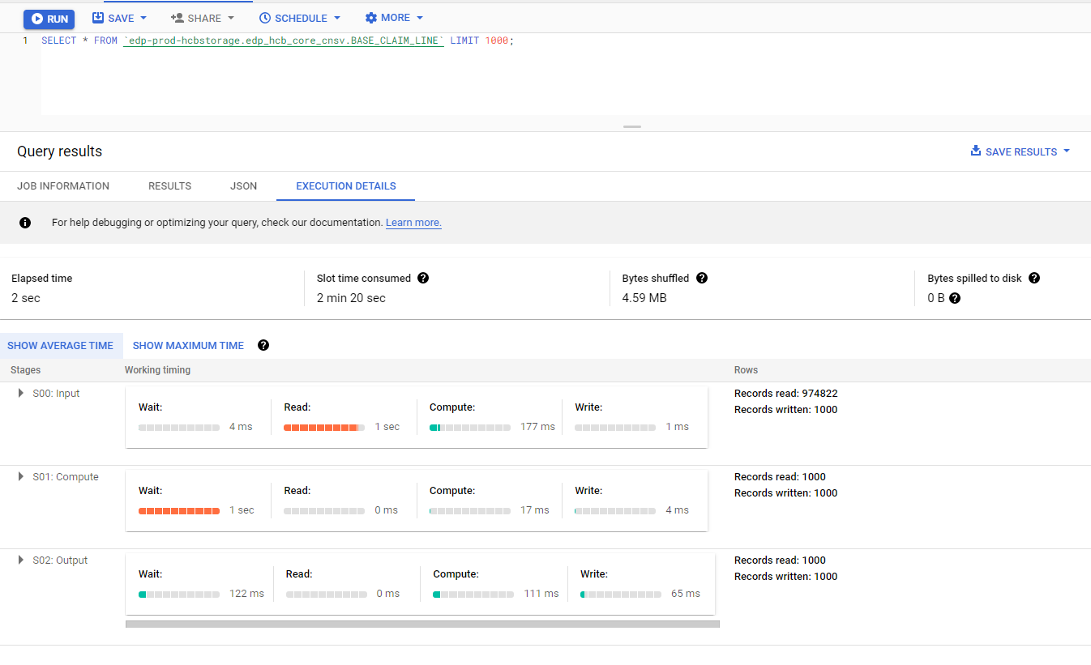
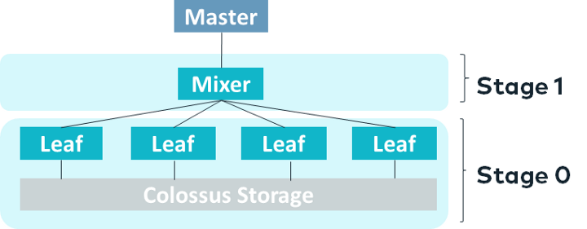
Query Optimization
Four main Stages
- Compute Phase
- Waiting Phase
- Read
A well-tuned query typically spends most of its time in the compute phase.
An average compute time close to max compute time indicates an even distribution of data coming out of the previous stage.

Slide 16
Narrow Table Scan
You pay for the columns you read
Don’t use “SELECT *”

Slide 17
Reference
https://storage.googleapis.com/pub-tools-public-publication-data/pdf/37217.pdf
https://cloud.google.com/bigquery/docs/query-plan-explanation
https://cloud.google.com/blog/topics/developers-practitioners/bigquery-admin-reference-guide-storage
https://research.google/pubs/pub36632/
https://medium.com/slalom-build/using-bigquery-execution-plans-to-improve-query-performance-af141b0cc33d
https://cloud.google.com/blog/topics/developers-practitioners/bigquery-admin-reference-guide-storage

Slide 18
Thank you

